Slide 1
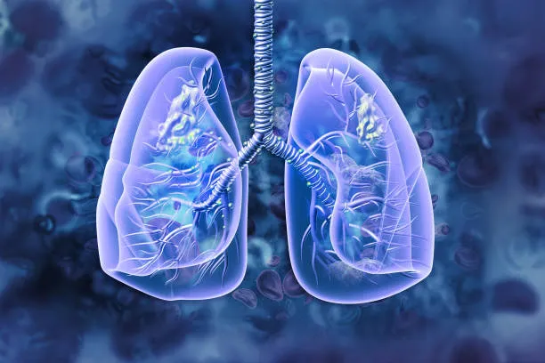
Lung cancer Prediction
-By Nishant Khatana

Slide 2

Lung Cancer Prediction Using Machine Learning
This presentation explores the development and application of machine learning models to predict lung cancer. We will cover the dataset, preprocessing, feature engineering, model selection, performance evaluation, clinical implications, and future directions.

Slide 3
Introduction to Lung Cancer
Leading Cause of Death
Risk Factors
Lung cancer is a leading cause of cancer-related deaths worldwide, accounting for a significant number of fatalities annually.
Smoking is the primary risk factor, but other factors such as air pollution, genetics, and occupational exposure also play a role.

Slide 4

Dataset and Data Preprocessing
Collection
Cleaning
The dataset used for this project includes medical records of patients, containing features like age, gender, smoking history, and diagnostic test results.
Data preprocessing is crucial for removing inconsistencies, handling missing values, and transforming data into a format suitable for machine learning algorithms.
Normalization
Data normalization is applied to ensure that all features are on the same scale, preventing bias in model training.

Slide 5

Feature Engineering
New Features
Feature Selection
Feature engineering involves creating new features from existing ones to improve the model's predictive power. This might involve combining features or creating interaction terms.
Feature selection techniques identify the most relevant features for predicting lung cancer, reducing noise and improving model accuracy.

Slide 6




Model Selection and Training
Logistic Regression
Logistic regression is a common choice for binary classification problems, predicting the probability of lung cancer.
Support Vector Machines (SVMs)
SVMs are powerful algorithms that find optimal hyperplanes to separate different classes, improving prediction accuracy.
Decision Trees
Decision trees create a series of branching rules based on features to make predictions, offering interpretability.

Slide 7

Performance Evaluation
1
Accuracy
Measures the proportion of correctly classified instances.
2
Precision
Indicates the proportion of true positives among predicted positives.
3
Recall
Indicates the proportion of true positives among all actual positives.
4
F1-Score
Provides a balanced measure of precision and recall.

Slide 8



Clinical Implications and Future Directions
Early Detection
1
Models can aid in early detection, enabling timely intervention and improving patient outcomes.
Risk Assessment
2
Models can assess individual risk factors, guiding personalized prevention strategies.
Treatment Optimization
3
Models can help doctors choose the most appropriate treatment based on individual patient characteristics.

Slide 9
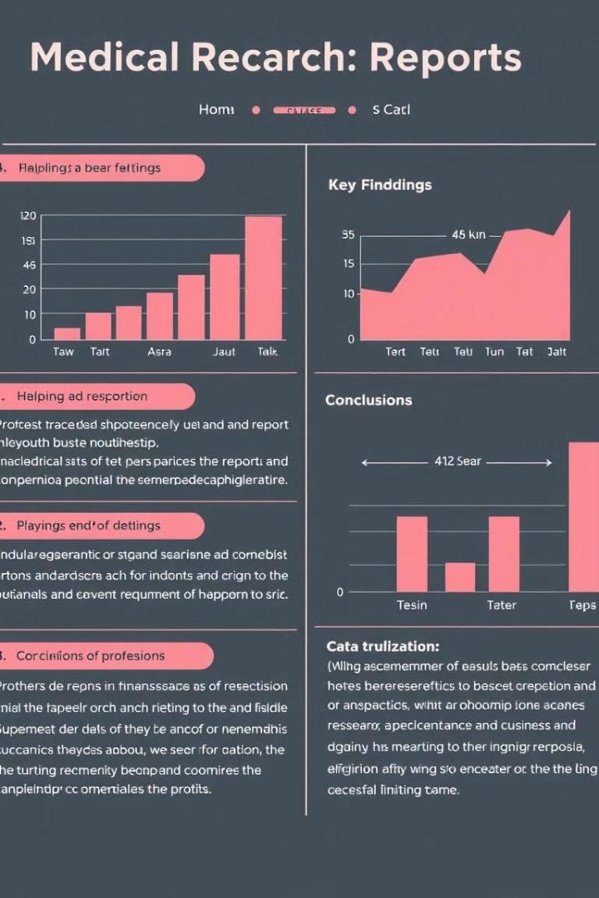
Conclusion and Key Takeaways
Machine learning holds significant promise for improving lung cancer prediction and management. The models developed in this project demonstrate promising results, offering valuable insights for clinical decision-making and future research.
regards

Slide 10


